Slide 1
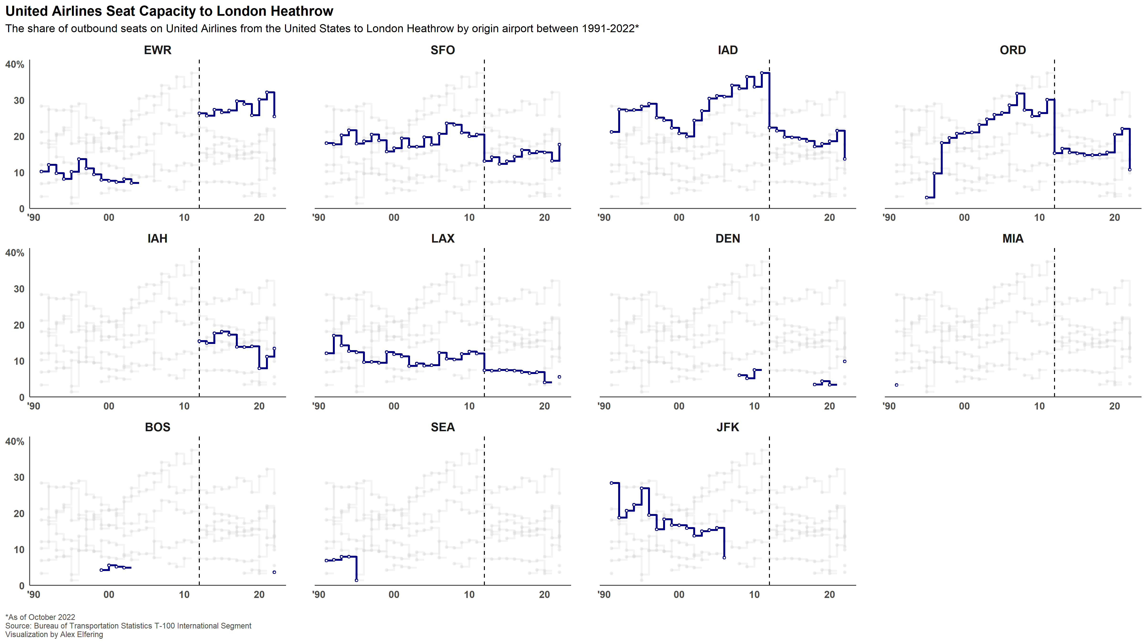
United resumed
after merging
with Continental
Last 747-400 service
to London in 2017
Continental
merger
MIA-LHR was one route
United purchased from
Pan Am in 1991 but later
discontinued
United sold the route to Delta in 2006
United flew 767-300s
Between BOS-LHR

